Slide 1

Instructional slide
Before you start...
The presentation is meant to be used by instructors to explain the importance of producing original work and to introduce their students to Turnitin Feedback Studio.
After presenting this deck, students will be able to do the following:
Interpret the results of the Turnitin Similarity Report
Revise their writing to change their Similarity Score
Use the Turnitin Similarity Report to improve their academic writing skills
Access Turnitin grammar and instructor feedback on their assignments
Consult speaker notes part of the slide for talking points, but feel free to tailor according to your students needs.
If your school has enabled Draft Coach, which provides real-time feedback to help students ensure original work, proper citations and correct grammar while they write, consider incorporating these intro slides.
Thanks for your commitment to academic integrity and for using Turnitin Feedback Studio!

Slide 2
Instructional slide
Navigating the deck...
Contents
3 Title
4 Agenda
5 Importance of Original Writing
7 Feedback Studio Overview
9 Turnitin Similarity Report
10 Using the Report to Improve Writing Skills
12 Navigating the Similarity Report
16 Interpreting the Similarity Report
21 Accessing Feedback (delete slides 21-23 if you don’t use Turnitin feedback and grading tools)
24 Resources
25 Q&A
Please look out for the helpful tips in the box!

Slide 3


Empowering You to Create Your Best, Original Work
Add your school or
institution’s logo here!
An introduction for students. Understanding the similarity report and using Turnitin Feedback Studio to improve your academic writing.
© 2021 Turnitin LLC. All rights reserved.

Slide 4
Agenda
Intro
Turnitin Feedback Studio
Turnitin Similarity Report
  What is it
  Navigating the report
  Interpreting the results
Accessing Feedback
Resources
Q&A

Slide 5

Why is original writing important?
A key expectation of academic work is that what you submit original work, and that you properly acknowledge outside sources and ideas that are not your own.
Writing with academic integrity is especially important because it allows you to contribute your own voice and understanding about the topic
In academia and the workplace, plagiarism is considered a serious ethical offense that could have drastic consequences for the future.
Original, innovative thinking is one of the most important skills needed for success in the 21st century workplace.
Robots and AI can never replace human original thought, organizations need creative employees who can conceive the solutions of tomorrow.
Notes:
As Steve Jobs once said, “Innovation distinguishes between a leader and a follower”.

Slide 6
Turnitin Feedback Studio
Let’s take a look

Slide 7

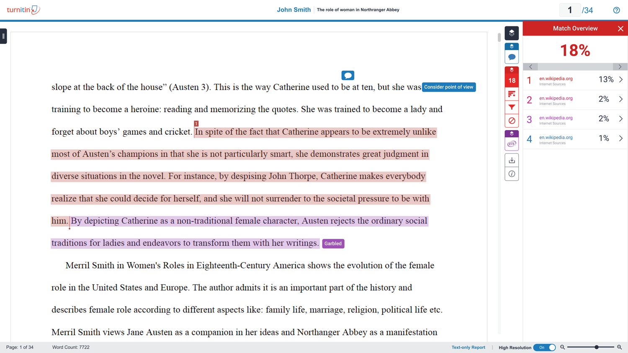
What is Turnitin Feedback Studio?
Turnitin Feedback Studio is an academic integrity, feedback, and grading tool.
Used by 34 million students and 15,000 institutions worldwide.
Feedback Studio can help you:
Cultivate writing excellence
Build critical thinking skills
Become university and
career ready

Slide 8
The Turnitin Similarity Report
Let’s take a look

Slide 9

What is the Turnitin Similarity Report?
The similarity report quantifies how similar your work is to other pieces of writing, highlighting any areas in your paper that match outside sources. The higher the number, the more similarity between your work and sources in Turnitin’s databases.
Each similarity report generates a similarity score which is the percentage of matching or similar text that has been uncovered. It’s NOT the percentage of plagiarized material in your paper.
Notes:
Information provided in the similarity report is used to determine if matches are appropriate or not based on the assignment expectations. The decision to deem any work plagiarized should be made only after careful examination of both the submitted paper and the suspect sources, not by simply viewing the similarity score.

Slide 10
Using the Report to Improve Your Writing
The similarity report results can help you make decisions about how to improve your writing, whether that is in later drafts of the same assignment or on future assignments.
You can use the report to:
  Check if you have properly attributed all outside sources in your paper.
  Practice correct referencing, quoting, and paraphrasing techniques.
  Identify places in the paper where the sources are crowding out your voice.
  Determine your writing strengths and target areas that need work.

Slide 11
Turnitin Similarity Report - Let’s Dive In!
Notes:
Here’s an example of a Similarity Report. Let's take a look and break down the different parts of the report.

Slide 12
Navigating the Similarity Report
Let’s take a look

Slide 13
Review all matching sources
—
The sidebar shows the Match Overview. This is where you can find the similarity score for your paper.
It is perfectly natural for an assignment to match against sources in our database. If you've used quotes and referenced correctly, there will be instances where we will find a match and that is totally OK!
Notes:
Here we are at the Similarity Insights panel. This is where you actually see that percentage, and for many people, that number is what they think of as “Turnitin.” (Spoiler: This is only a small part of what Turnitin does/offers.) It is, however, a very important feature. Let’s start by talking about exactly what this percentage represents. In the simplest terms, the higher the number, the greater the similarity between your work and other sources. The follow-up question here is ALWAYS (no matter the audience, no matter where in the world): what is a “good” score? The trick is there is no single answer to that question. There isn’t a number that is the “right” answer b/c what that number means depends on a lot of variables. There are, however, some guidelines that can help you interpret the number and decide whether it is “good” or not.
First, let’s establish a very important baseline: 0% is not the goal. A lot of people start out by assuming that any number above 0% is bad and that if you have any value above 0%, you have done something wrong. That’s definitely not true. There is almost always a level of what we call “expected text similarity.” Expected similarity means that there are certain elements that we expect to show an overlap with other sources. Common facts or information, is almost always going to show minor overlap and doesn’t require citation. If you’re doing research or providing evidence from a source or sources (which is true of MOST academic writing), you will have quotes and paraphrases, which will show up as matches; however, as long as you have cited those things, that is not only acceptable but should be encouraged. Let’s also remember that there are key phrases that are inherent in certain domains. Those, too, might trigger similarity. By itself, that’s nothing to be alarmed about.
In fact, in most of these cases, Turnitin solutions have filters that allow you to see if these elements are impacting your percentage. We’ll talk more about those in a bit. The biggest problem here is that students often don’t know how to interpret the score and then determine what to do next. Let’s talk more about the actual strategies you can take to address concerns with your score.

Slide 14
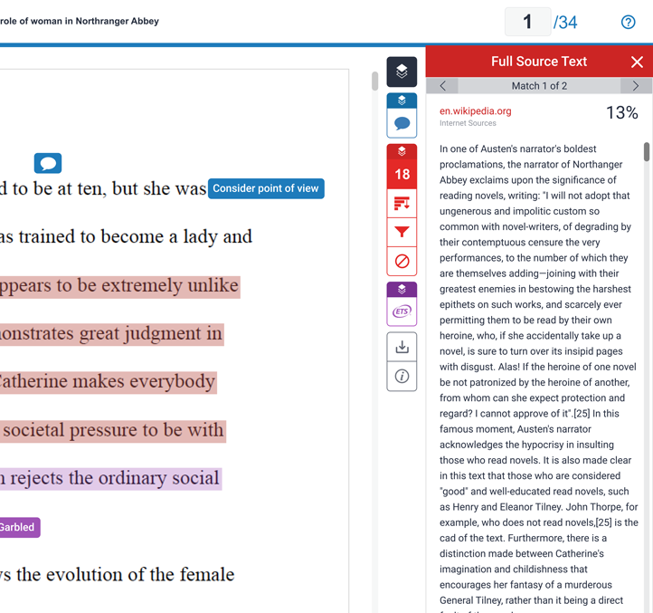
Explore matches in more detail
—
Easily scroll through multiple matches of a source
(e.g. wikipedia.org). Each match is color-coded to help you easily identify where they’re located in the paper.
See a preview of the matching text along with the source url, which can be opened in-browser.

Slide 15
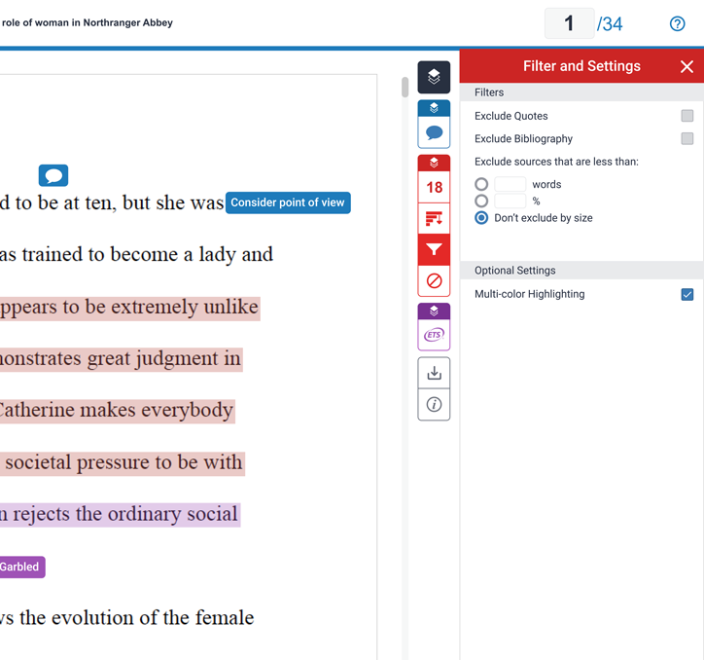
Exclude unwanted content
—
You can also use filters to focus in on certain matches to understand where the similarity is occurring.
Exclude bibliography sections or text in quotes that Turnitin has detected and see how that impacts your similarity score.
Notes:
You can also use filters to focus in on specific elements of similarity. For example, you can exclude your bibliographical sections OR hide text in quotes. Why might you want to do that? Well, doing so can help you focus in on exactly where your similarity is occurring and that gives you a much more targeted approach to understanding issues and making changes (either on this assignment, if revisions are possible, or on future assignments). These filters will let you see how those different exclusions impact your score. IMPORTANT, though, to remember that these filters are only impacting your view - this doesn’t change the overall report that the instructor will see, unless he/she changes the assignment filters. Even so, though, this can really help you pinpoint how different components of your writing impact the similarity score.

Slide 16
Interpreting the Similarity Report
Let’s take a look

Slide 17

What should I do if my score is too high?
This means that too much of your paper comes from other sources. Consider the following to lower your similarity score:
Balance the information that you use from texts with your own writing.
Determine when it would be most appropriate to paraphrase, summarize, or explain an idea in your own words.
Properly cite each source that your reference.
Notes:
First and the one most people worry about: What if my score is too HIGH? This means that too much of your writing is coming from other sources or, another way to look at it, there aren’t enough of YOUR ideas in the paper. What can you do about that? First, you want to balance out the information that you use from texts with your own ideas. Zero in on the places where you have relied heavily on outside sources and ask yourself what ideas you can add? Perhaps this means you need to explain or analyze the outside source content; perhaps it means you don’t need ALL of the outside source content. Making adjustments in either of these ways will impact the similarity percentage. What else? Well, take a really hard look at how you are integrating outside source info. Are you consistently quoting outside sources when you might be able to paraphrase or even summarize that information? Varying these strategies can also impact that similarity score. And then finally, check the citations! Regardless of where that percentage falls, you must be absolutely militant about citations.

Slide 18

What should I do if my score is too low?
This means that too little of your paper comes from other sources. Consider the following to lower your similarity score:
Balance your own writing with the information that you use from other sources.
Determine when it would be most appropriate to quote directly from a source or paraphrase information to add research-based support for your claim.
Properly cite each source that you reference.
Notes:
Now, what if your score is too LOW? People often don’t think about this much, but this kind of score is also potentially problematic. One of the first things you have to consider here is exactly what kind of writing assignment this is. Is it a creative writing assignment? It might be just fine if there is a very low similarity score! However, if it is an assignment where you are expected to collect and synthesize information or use evidence to support and elaborate on your ideas, this is really just as big a problem as a score that is too high. It isn’t a plagiarism issue, but it is still a concern. Why? Well, because this means that too little of your paper comes from other sources, or, to put it another way, you don’t have much support or evidence for your ideas. That is definitely not okay. So what to do about it? The first step is to make sure that you are balancing your own ideas with information from other sources. Ask yourself if there is data or an example from other sources that would help to reinforce what you have said. If it’s controversial or debatable, ask yourself what points from outside source could be used to validate or support your ideas. Determine whether there are specific quotes or paraphrases that would be powerful. I always told my students if there is a particular authority in the field or someone with deep expertise and experience, that’s a good time to look for a quote. If there is a source that is able to explain ideas in particularly meaningful, colorful, or memorable ways, that is a good time to incorporate a quote. IF there is someone whose lived experience is impossible to replicate, make sure that voice shows up in your writing. As you’re doing this, you’ll want to think about where to place these ideas so that they have the greatest possible impact on clarifying, supporting, or extending your own ideas. All of these steps will start to impact your similarity score, but remember that 0% similarity is not the goal. And above all else - make sure you cite!

Slide 19

What should I do if large sections of my paper come from a source?
This means that too much of your paper comes from other sources. Consider the following:
Include your own words in your writing where necessary.
Select only the most important part of each quote, rather than including an entire paragraph that includes extraneous information.
Explain each quote that you reference, offering an analysis
of how it applies to your claim.
Notes:
Much like we discussed when we looked at the score being too high, you have to consider how that works across the paper. Is all the evidence you have coming from a single source? Or do you have huge sections that are predominantly from a source or sources? If you have a huge section that comes from a source or sources, make sure you evaluate whether you need ALL of that. Pick the most important ideas to include in your paper, not every little detail… and be sure to add in your own explanation or analysis. YOUR ideas should never be absent from your paper. And think about how to space that out across the paper. You don’t want to have the voice of your outside sources consuming most of your paper. Consider going quote-by-quote and adding an explanation for each one. That will help to balance your ideas with those outside sources.

Slide 20

What should I do if large sections of my paper are only my words?
This means that too little of your paper comes from other sources. Consider the following:
Include research-based information that can support your claim.
Properly cite each source that you reference.
Notes:
Okay, now what about the opposite end of the spectrum? What if whole sections of my paper are ONLY my words, with no outside sources? Again, make sure you consider the specific writing assignment and whether that’s appropriate. Assuming that you are trying to incorporate evidence or support from other sources, stop and consider your major ideas and ask yourself what research-based information can be added to enhance those ideas. Where might a powerful quote or statistic help to clarify or strengthen your ideas. If you go point-by-point and look for an outside source to bring in, you’ll move toward a better balance. And again - DON’T FORGET TO CITE!

Slide 21
Accessing Grammar & Instructor Feedback
Let’s take a look

Slide 22
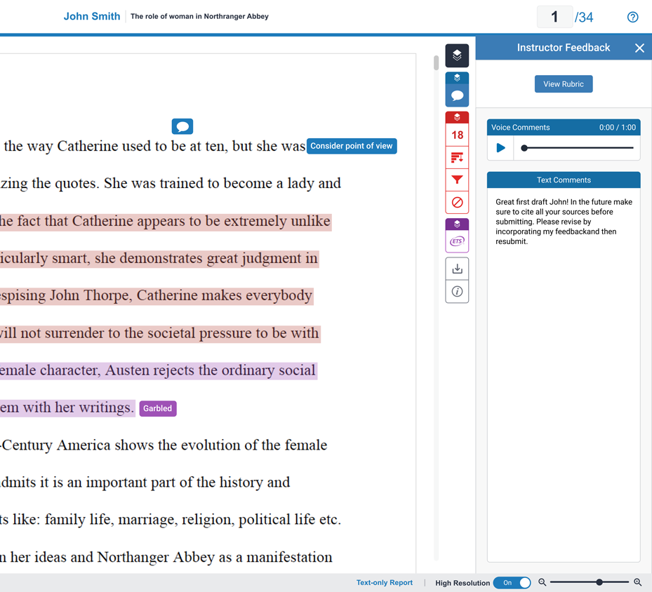
Instructor Feedback
—
Feedback Studio allows instructors to leave the following types of feedback directly on similarity report:
Annotations
Text & Bubble Comments
QuickMarks (pre-saved comments)
Voice Comments
Summative Comments
The feedback appears as blue markings and text on your similarity report. This may include comments on positive aspects of your paper, how you can improve in the future, or issues with your paper.

Slide 23
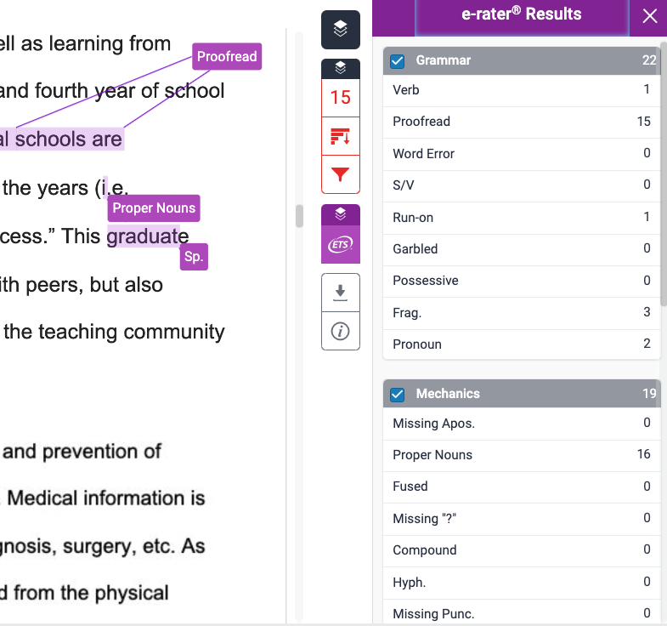
Grammar Feedback
—
Feedback Studio also provides automated feedback that highlights possible mistakes in grammar, usage, mechanics, style, and spelling.
The feedback appears as purple comments on similarity report.
Use this feedback to evaluate your essay-writing skills and identify areas that need improvement.

Slide 24

Need more help?
Check out these helpful resources:
Student Resources Hub
Student Quick Start Guide
Student Help Guides
Turnitin Resources
Turnitin Blog

Slide 25
Questions?

